Slide 1


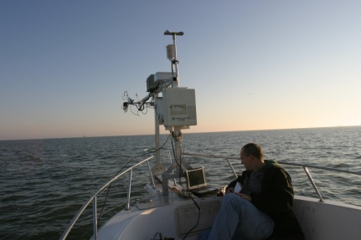
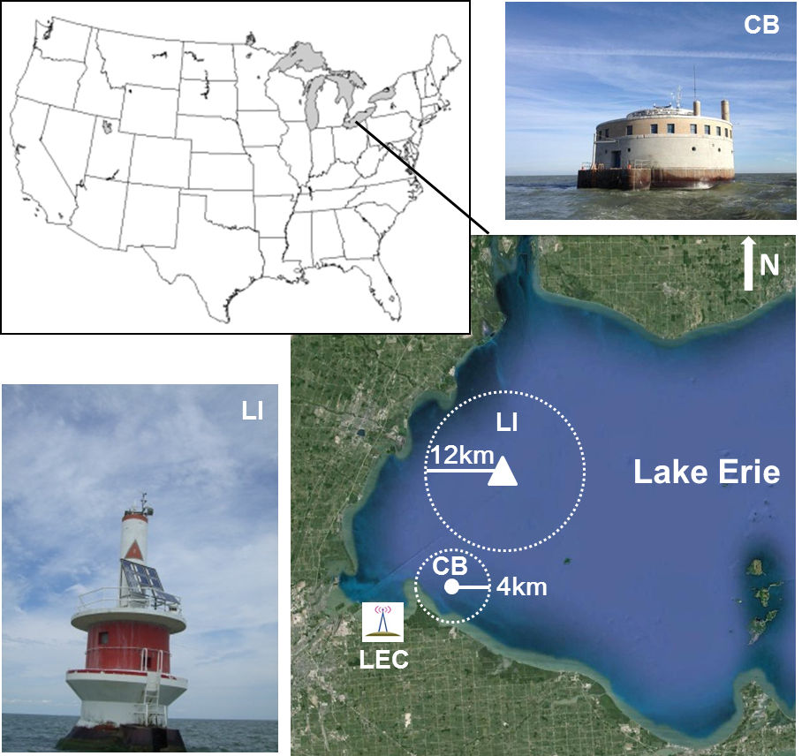
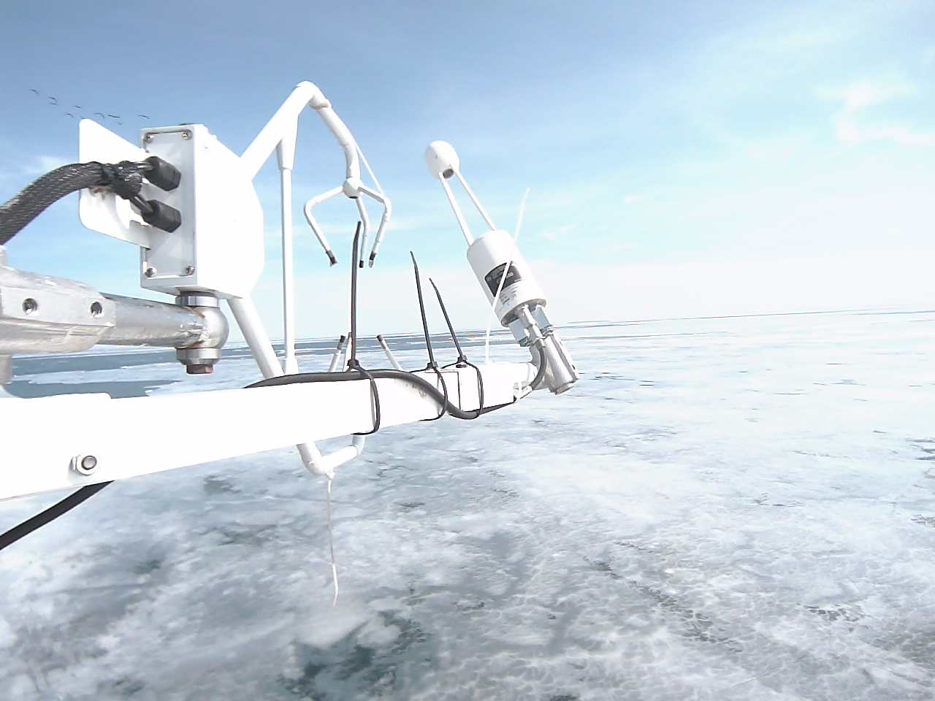
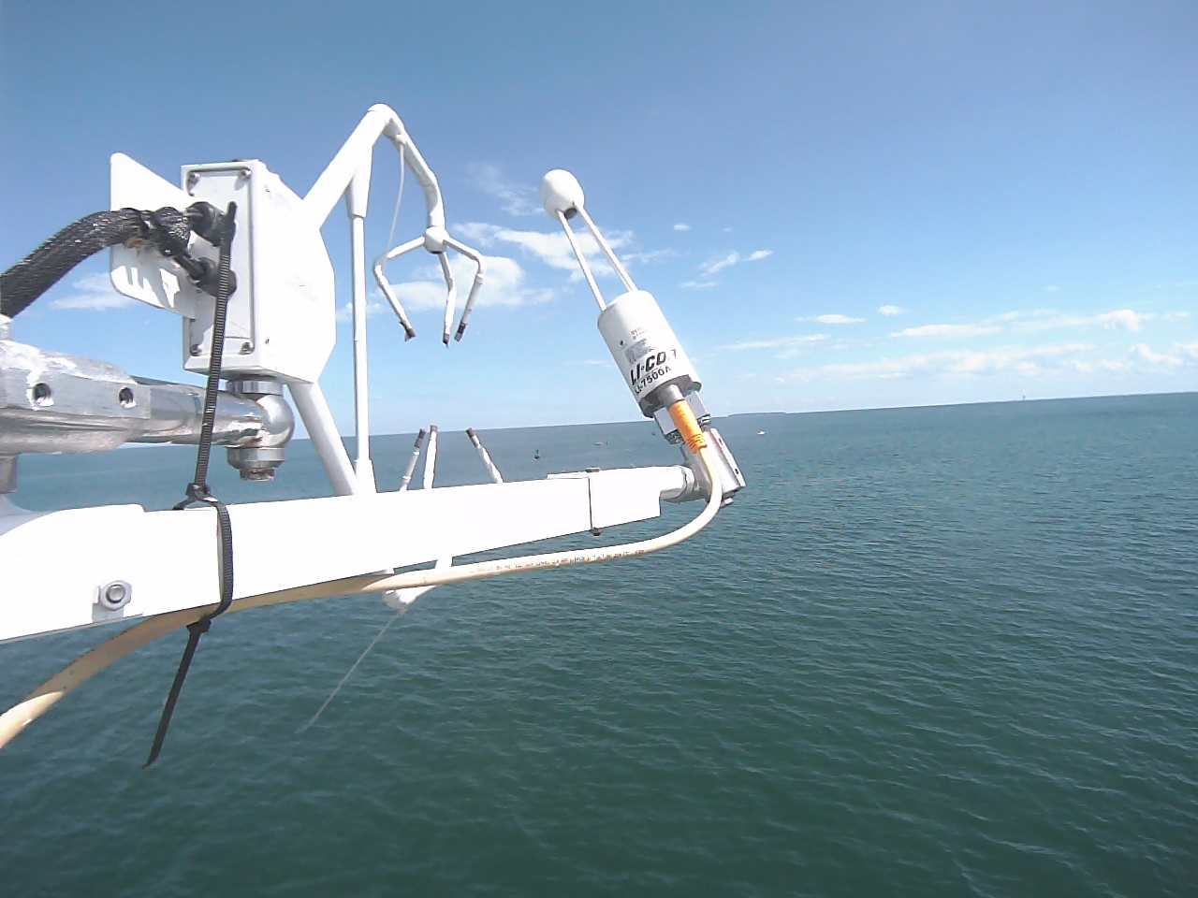
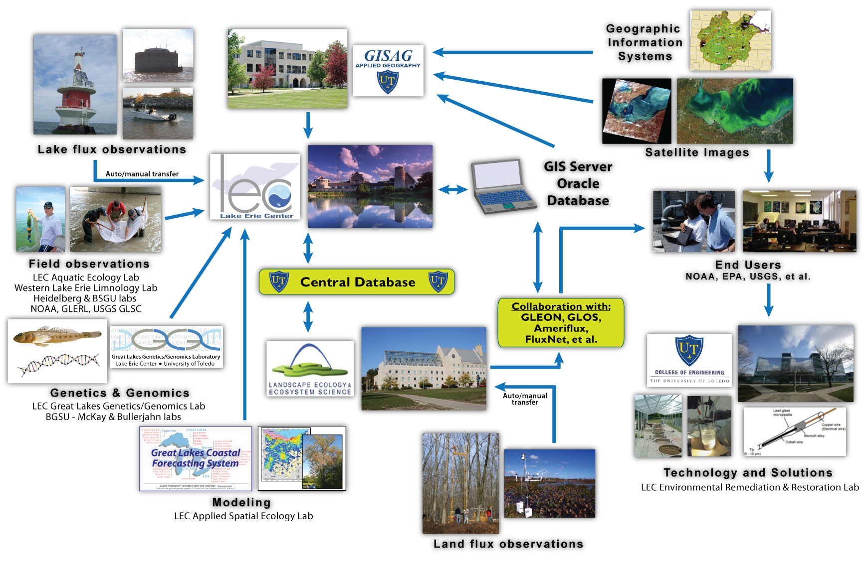
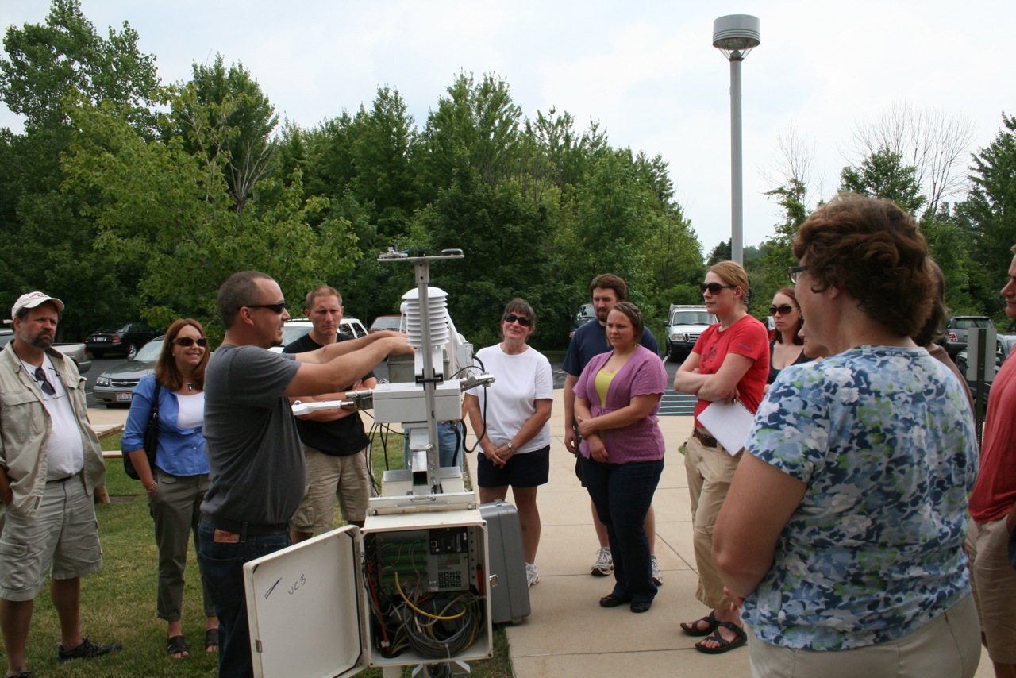


JASM 2014
ID: 153
A NEW LAND-LAKE SENSOR NETWORK FOR MEASURING GREENHOUSE GAS, WATER, AND ENERGY EXCHANGES: USE IN EDUCATION AND OUTREACH
Stepien, Carol A*., Chen J., Shao C., Czajkowski, K. P., Bridgeman, T. B., Richard Becker
Lake Erie Center, Depts. of Environmental Sciences and Geography and Planning, University of Toledo, OH, USA
email: carol.stepien@utoledo.edu
1. Introduction
3. Research Sites
4.2. Results: Daily CO₂ fluxes
4.4. Results: Monthly C and energy fluxes
Researchers at the Lake Erie Center built a real-time sensor network to evaluate carbon/water cycling in western Lake Erie, measuring the net exchanges of CO₂, H₂O, and energy between the lake and the atmosphere. Additionally, lake algal concentrations were monitored via chlorophyll a and phycocyanin sensors during summer months. The network of two permanent lake stations and a mobile vessel-based platform was linked with similar stations on adjacent lands. During 2011, when Lake Erie experienced a record-setting late summer-fall bloom of the toxic cyanobacterium Microcystis, we found that: (1) Western Lake Erie acted as a small carbon sink in summer but as a carbon source overall, (2) sensible heat flux (H) lacked obvious diurnal or seasonal changes, with latent heat (LE, equivalent to evaporation) dominating in summer, and (3) July had the maximal CO₂ uptake, when water chlorophyll content increased and the Microcystis bloom was expanding rapidly. We have interfaced use of sensor network data in undergraduate and graduate training, along with public outreach and high school classroom exercises through the Lake Erie Center’s educational programs.
http://www.utoledo.edu/nsm/lec/sensor_network/index.html
Monthly C revealed that Lake Erie served as a carbon sink in the summer and as a carbon source in winter. Uptake C was 43.8 in 2012 and 14.6 g C m⁻² in 2013 (May-Sept).
Annual LE (latent heat) variation showed a single-peak curve change, with annual cumulative evaporation in 2012= 740 (CB) and 640 mm (Ll), and in 2013= 710 and 650 mm, compared to annual rainfall in 2012= 670 and 2013= 710 mm.
H (sensible heat) lacked seasonal patterns, matching the daily trends. H was ~¼ of the annual LE.
4.1. Results: Micrometeorology
Period |  | LE (W m⁻²) | H (W m⁻²) | C (g C m⁻² d⁻¹)
2012(May-Sept) |  | 7.82(2.39) | 1.28(0.31) | -0.12(0.32)
2013(May-Sept) |  | 6.43(1.65) | 1.45(0.47) | -0.04(0.32)
2012(Oct-Apri) |  | 2.68(1.50) | 0.69(0.52) | 0.42(0.20)
2013(Oct-Apri) |  | 2.83(1.60) | 0.78(0.23) | 0.57(0.32)
2011-12 |  | 4.82(3.21) | 0.93(0.53) | 0.19(0.37)
2012-13 |  | 4.33(2.41) | 1.05(0.47) | 0.32(0.44)
At LI, there was no diurnal variation of CO₂ flux, even between day and night. Mean eddy covariance measurements revealed a small but measurable downward flux from May-Sept. in both years. The lake acted as a small carbon sink in the summer and a carbon source in winter, with the efflux rate varying from -0.45-0.98 g C m⁻² d⁻¹.
4.5. Results: Linking C to water properties
4.3. Results: Regional comparison C sequestration among ecosystems
Relationships were found among daily carbon net ecosystem exchange (NEE), water chlorophyll content, and Microcystis biovolume. CO₂ uptake increased with water chlorophyll content.
2. Training class
Wind speed (U) was 6.3 (CB) and 5.6 m s⁻¹ (LI) at the Western Lake Erie sites, driven by synoptic weather, reaching 15.0 m s⁻¹ with substantial turbulent mixing. Annual mean air temperatures (Ta) were 2012: 12.2°C (CB), 12.0°(LI); 2013: 10.4°,9.9°. The water vapor pressure deficit (VPD) was higher at CB in both years (2012: 0.6, 0.5 kPA, 2013: 0.5, 0.4). Photosynthetically active radiation (PAR) was 2012: 27, 2013: 25 mol m⁻² d⁻¹. Rainfall (PPT) showed little monthly variability, 2012: 50-70 mm (May-Oct) and was greater in August (~100 mm). In 2013, maximum PPT reached 100 in June and 150 mm in July. Total annual rainfall was 670 in 2012 and 710 mm in 2013.
5. Conclusions
From an annual perspective, western Lake Erie acted as a carbon source, but as a small carbon sink in summers.
Lake evaporation was much lower than terrestrial ecosystems, and significantly lower than models predicted (1/7; e.g., Croley 2005:Recent Great Lakes evaporation model estimates.http://www.glerl.noaa.gov/pubs/fulltext/2005/20050015.pdf ) .
Lake latent heat showed an obvious seasonal pattern, with greater energy than the sensible heat values. Turbulent energy totaled <40% of the global solar radiation; thus water heat storage contributed >1/2 of the input energy.
We have been designing high school classroom exercises, using our real-time Network data.
Scaling our results, the entire Western Lake Erie Basin：
releases 4.78×10⁵ tons of C per year.
This carbon loss is equivalent to:
1/3 sink of the natural forests
or 1/4 of the watershed’s croplands
GK12 demo class in learning the sensor network
Acknowledgements:
This study was partially funded by the FSML(Field Stations and Marine Labs) program of the NSF (1034791), NOAA, and USDAFS.

